Slide 1
IMPORT FF TABLES IN HANA
Milind Parab

Slide 2
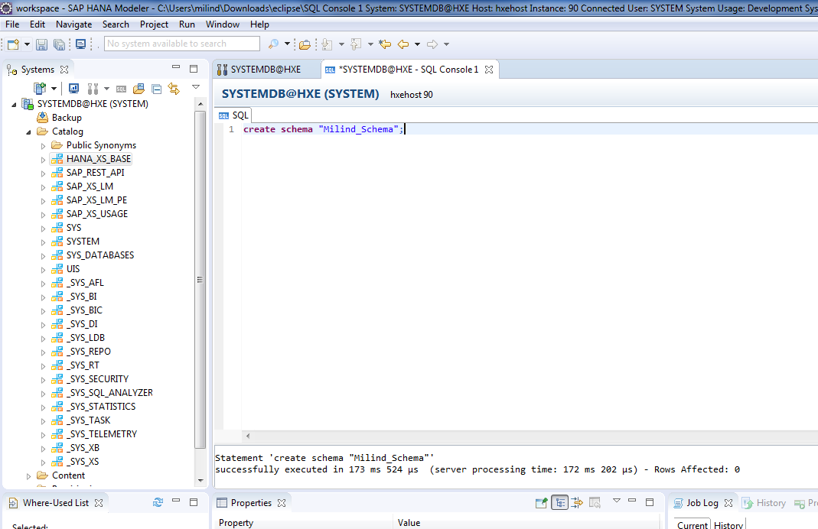
Open SQL console and create schema.

Slide 3
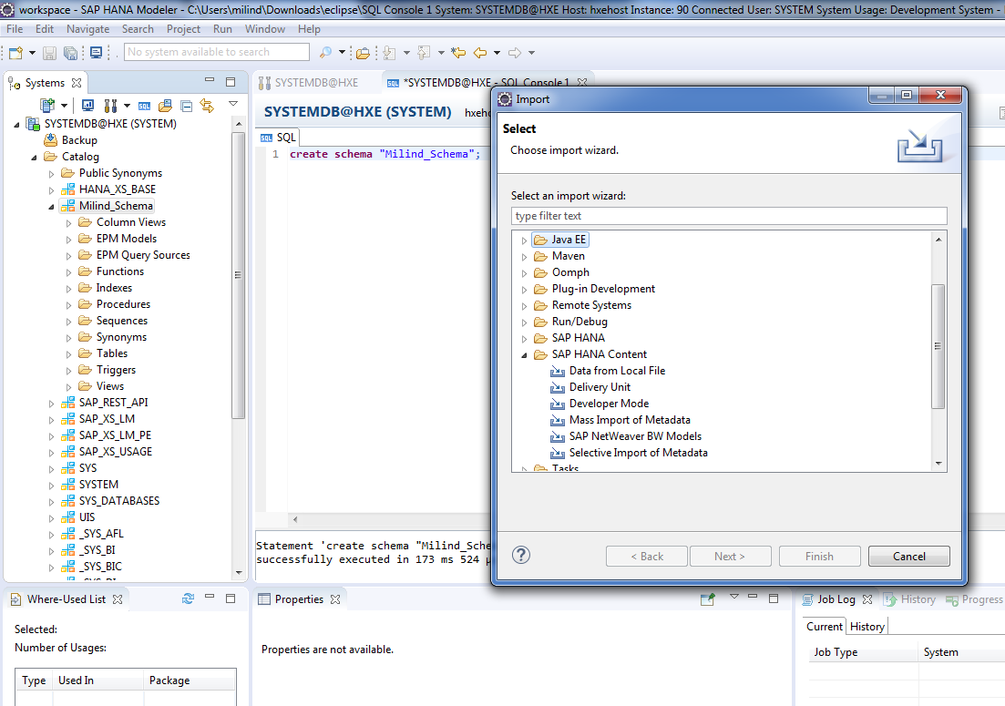
Click on import→ SAP HANA content→ Data from Local File.

Slide 4
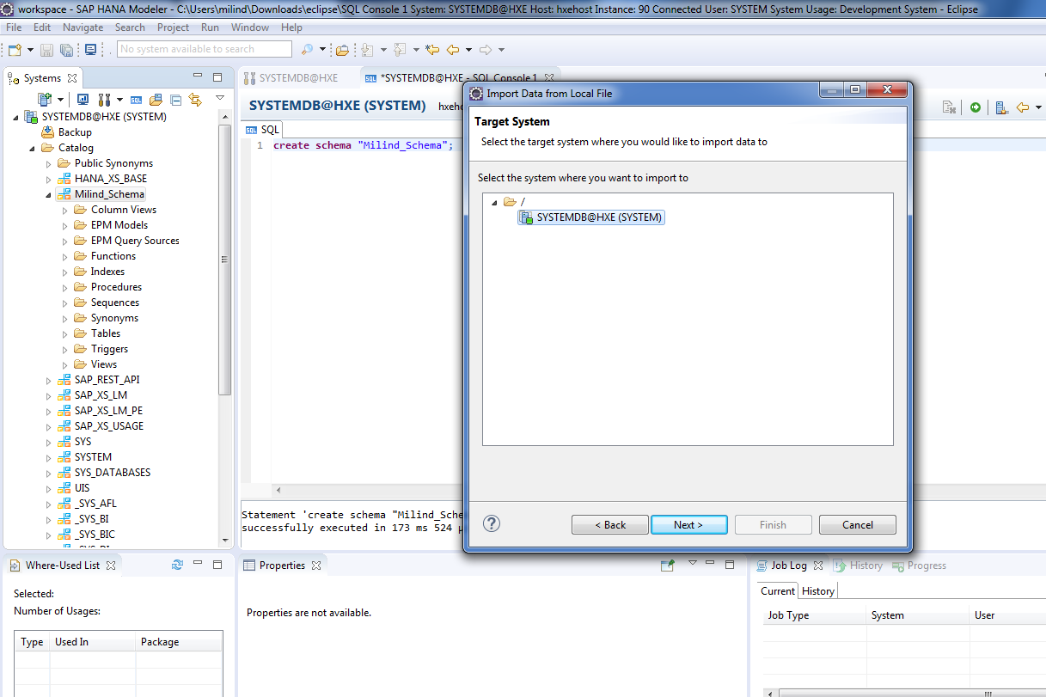
Select HANA system.

Slide 5
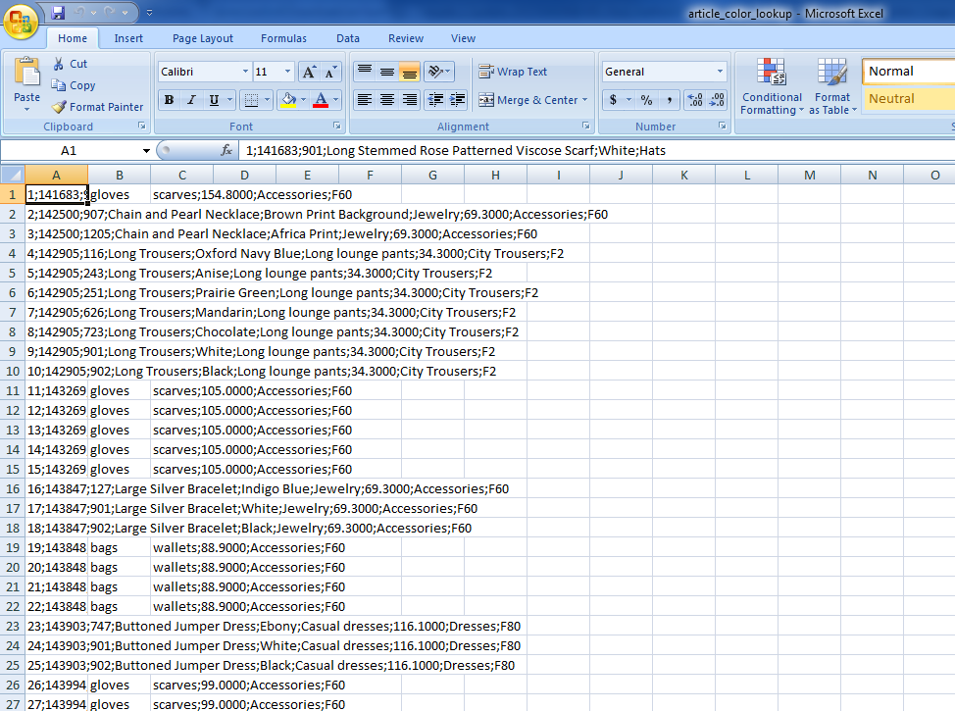
This is the table in FF.

Slide 6
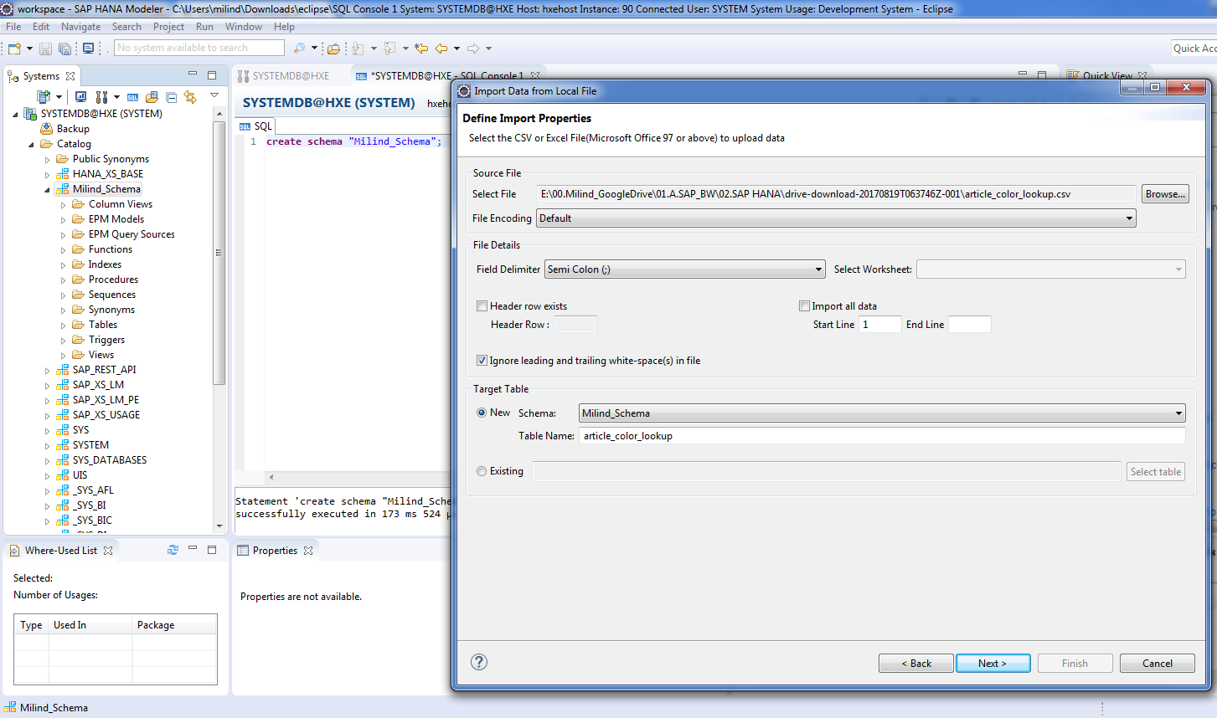
Cont.

Slide 7
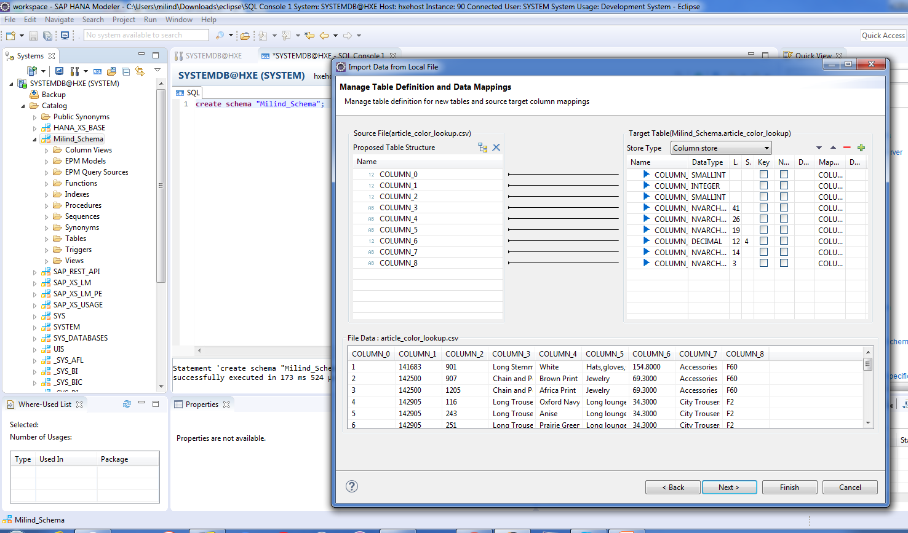
Cont.

Slide 8
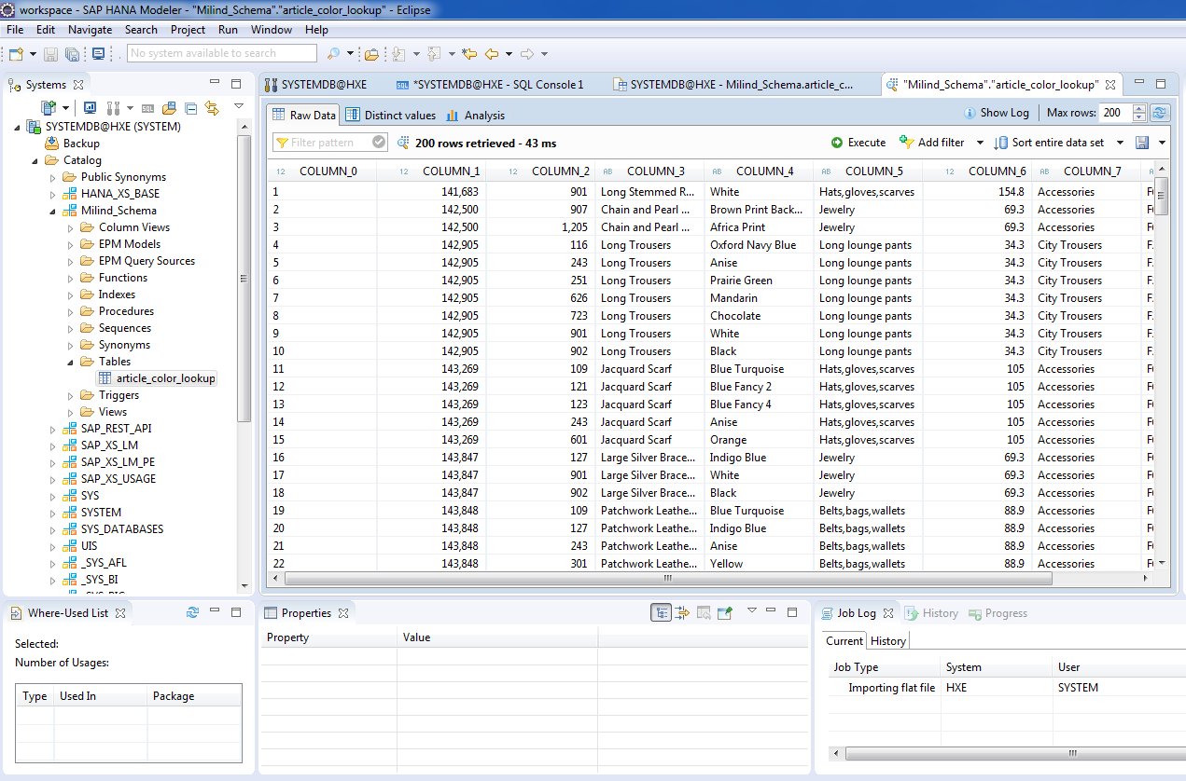
Check data preview.

Slide 9
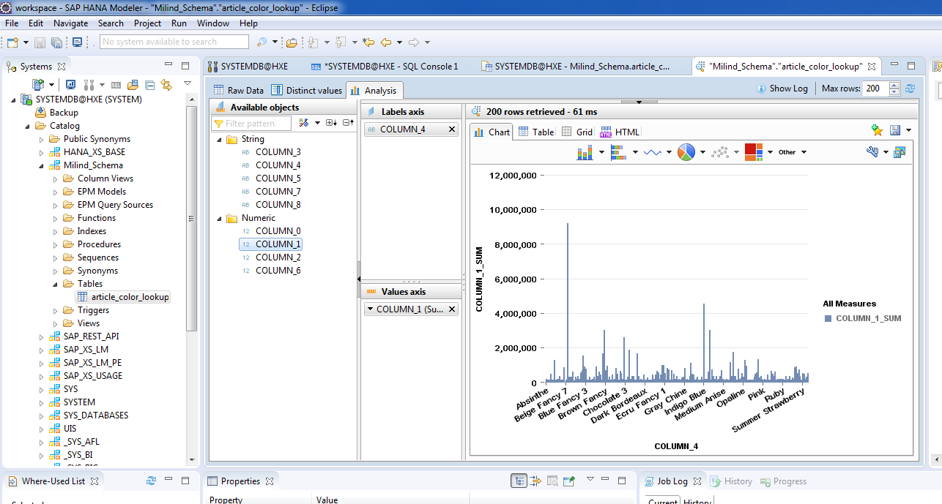
You can also check how data looks in the report.

Slide 10
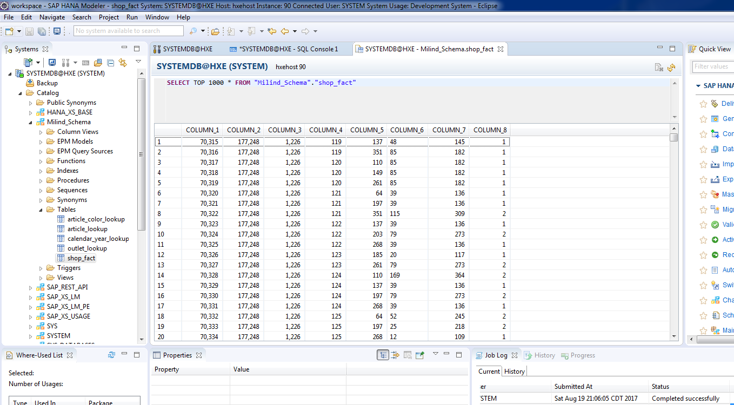
Similarly import all other tables.

